Slide 1
Topic: Quadruped Robots For Educational And Industrial Purposes
Presented by:
Aishwarya Zope
Aidtya Pawar

Slide 2
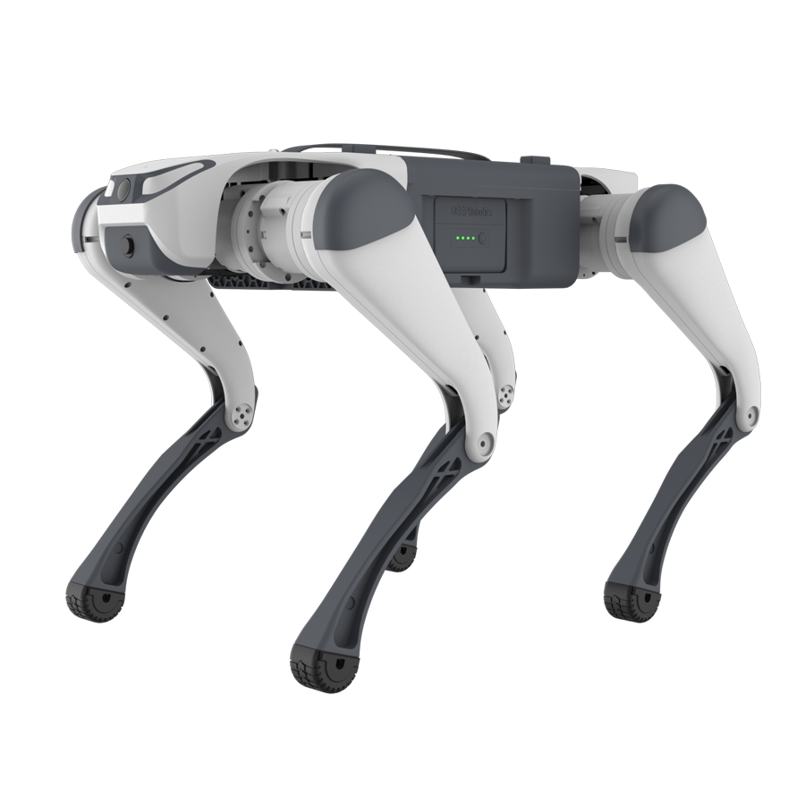
Deep Robotics Lite 3Quadruped Robot Dog : Next generation AI Powered Quadruped
Structure: Lightweight yet strong body made of aluminum alloy and carbon fiber, ensuring a high strength to weight ratio. Each of the four legs has 3 DoF
Weight 12kg
Dimensions: 0.7 m (length) × 0.3 m (width) × 0.4 m (height) - varies slightly by version.
Dynamic balance is maintained using IMU data and force feedback from legs.
9-axis (Accelerometer + Gyroscope + Magnetometer)
RGB or Depth Camera (optional module)
SLAM, object tracking, environment mapping
Joint encoders: Measure joint angles precisely
Force sensors/torque sensors: Detect foot-ground
interaction forces
Connectivity: Wi-Fi / Bluetooth / Ethernet
Remote control via PC/tablet/smartphone
SDK support for Python/C++ and ROS

Slide 3
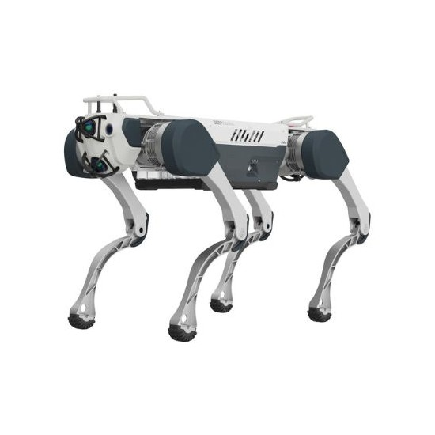
X30 Quadraped (marvick tactical)
Dimensions 1 m × 0.7 m × 0.47 m and weigh around 56 kg (with battery)
Temperature Range: Operates reliably from –20 °C to +55 °C
Ingress Protection: Rated IP67, making it robust against dust and water
X30 recognizes/detects suddenly approaching humans and obstacles, autonomously avoiding/navigating them to prevent collisions
Each of the four legs includes multiple servo-driven joints, likely using high-torque BLDC motors with onboard gearboxes and position control.
Typically outfitted with 2 front and 2 rear 360° LiDAR units, enabling SLAM, mapping, and obstacle avoidance
Camera Systems: one wide-view RGB camera, often paired with thermal
or depth sensors for enhanced situational
awareness in low-light conditions
IMU Sensors: supports dynamic posture
adjustments and stability during movement.
Proximity and Collision Systems: Fusion of visual and distance data enables
effective avoidance of moving and static obstacles

Slide 4
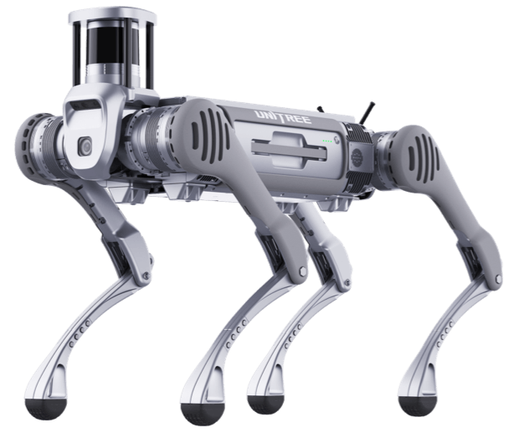
Unitree B2
Weight: 60 kg (battery included)
Standing size: 1098 × 450 × 645 mm; folded: 880 × 460 × 330 mm
IP67-rated, able to operate in temperatures from –20 °C to +55 °C
Battery: 45 Ah lithium pack (2.25 kWh),
LiDAR 3D LiDAR delivers 360° point-cloud maps for SLAM and obstacle avoidance
Depth Cameras: Dual Intel RealSense D435i for front and rear depth perception
Optical Cameras: Two RGB visual cameras for
object detection and environmental awareness
IMU and Joint Encoders
Software & Networking
Supports Wi‑Fi 6, Bluetooth 5.2, Ethernet,
USB 3.0; ROS-based control, API available
in C++/Python

Slide 5
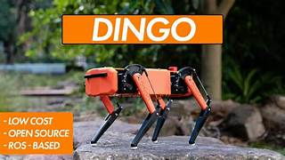
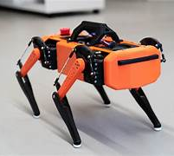
Ditting S10 dingo
Compact size (38 × 25 × 25 cm) and lightweight (3 kg)
Each of the four legs uses 3 high‑torque servo motors
Core control via a Raspberry Pi, complemented by an Arduino Nano for interfacing with analog sensors
Excellent as a budget-friendly platform for studying locomotion, control systems, ROS integration, and learning robotics fundamentals.
The Ditting/Dingo S10 is an affordable, open-source quadruped built for education and research. Featuring 12 servo‑driven joints, ROS‑based control with Gazebo simulation, and expandable sensor capacity, it’s ideal for robotics labs, student projects, and early-stage algorithm testing.

Slide 6
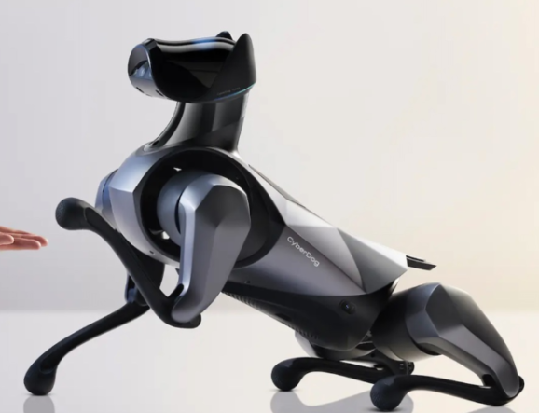
Xiaomi cyber-dog
1st-gen CyberDog (2021): approx. 77 cm × 35 cm × 40 cm, 14 kg
2nd-gen CyberDog 2 (2023): more compact (56 × 34 × 48 cm), 8.9 kg
Rigid body of carbon fiber, aluminum, and ABS.
Real-time SLAM mapping, obstacle avoidance, human/object tracking, gesture and voice command response
Vision camera AI interactive, fisheye (wide-angle), Intel RealSense D450/D430 depth cameras
1st-gen had 11 sensors; 2nd-gen expanded to up to 19, adding LiDAR, additional ToF, ultrasonic sensors, UWB, and force sensing .

Slide 7
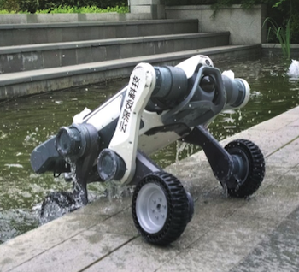
Lynx M20 (deep robotics)
Only 33 kg, portable by one person; dimensions approx. 820×430×570 mm
Rated IP66, operable from –20 °C to +55 °C
It uses advanced SLAM (Simultaneous Localization and Mapping) technology with 96-line LiDAR and a wide 360°×90° field of view for precise 3D terrain mapping and real-time obstacle avoidance.
Equipped with dual-spectrum cameras and sensors, LYNX M20 can detect thermal anomalies, gas leaks, and abnormal mechanical sounds, helping maintenance teams quickly identify and respond to faults. It also auto-generates inspection reports, further streamlining operations.

Slide 8
Costing/Pricing
X30 Quadraped (marvick tactical) : $175000 (available on deep robotics official website and Marvick tactical official website)
Unitree B2: global price is $83000 (available on unitree website) and ₹93 lakh (distributer :Bidyut innovation pvt. ltd. From Indiamart)
Lynx M20 deep robotics: approximately US $18K(base version)
Xiaomi cyber-dog : $1,785 USD (not officially sold in india)
5. Lite 3Quadraped Robot Dog: ₹ 3,90,000 (Next generation robots – available on indiamart)
6. Ditting S10 dingo: $1300 AUD

Slide 9
Robot Name | Price in India | Global Price | Notes
X30 (Marvick Tactical) | - | $175000 | High-end tactical-grade quadruped from Deep Robotics.
Unitree B2 | ₹93 lakh | $86000 | Industrial-grade; price depends on configuration.
Lynx M20 (Deep Robotics) | - | US $18K(base version) | For industrial/heavy-duty use; inquire with Deep Robotics directly.
Xiaomi CyberDog (Gen 1/2) | - | $3000 | not officially sold in India.
Lite 3 (Deep Robotics) | ₹ 3,90,000/-(india mart) | - | Mayura Automation & Robotics pvt. Ltd. (Distributer/supplier).
Ditting S10 Dingo | - | €1,200 | Dev/testbed robot; used in research/education.

Slide 10
1. Overall Best(if you're on a reasonable budget):
→ Lite 3 (Deep Robotics)
It offers professional-grade walking, AI integration, and decent terrain capability at a moderate cost.
Use for: Robotics labs, AI navigation testing, logistics prototyping, and surveillance research.
2. Best for Education, Prototyping:
→ Xiaomi CyberDog or Ditting S10 Dingo
They’re affordable and good for learning SLAM, AI vision, ROS, and mobility basics.
Ideal used for: Universities, tech enthusiasts, robotics clubs, Industrial application
3. Best for Deployment in Industry and Field Use:
→ Unitree B2
Excellent performance, proven deployments in logistics and inspection.
Caveat: Needs expert setup and high maintenance.
4. Not Recommended (Unless Required by Application):
X30 (Tactical) and Lynx M20: Too costly unless you're in military, border security, or heavy factory automation.

Slide 11
Secondary Development Quadruped Robots
Robot Name | Manufacturer | Ideal For | Key Development Features
Unitree Go1 Edu | Unitree Robotics | AI, SLAM, control research | ROS/ROS2 support Open SDK (Python/C++) Depth cam, IMU, AI tools
Unitree B2 | Unitree Robotics | High-end R&D, industry | ROS, SDK, Visual SLAM, LIDAR, 40 kg payload
Xiaomi CyberDog 2 | Xiaomi | gesture, voice control | Limited SDKGood for basic AI & control via app
Lynx M20 | Deep Robotics | Industrial R&D, SLAM | LIDAR, stereo vision, ROS SDK, IP67 rugged body
A1 Edu | Unitree Robotics | Affordable AI learning | ROS1/ROS2 SDK, Visual + IMU, AI Edge support
Lite 3 | (Various OEMs) | Educational use | Depth camera, IMU, edge AI support, SDK possible
AlienGo | Unitree Robotics | Advanced mobility research | Advanced AI + perception SDK, ROS, LIDAR support

